Slide 1
Testing Prestashop Website
Team Members:
1. Shahd Ashraf 2. Habiba Saad
3. Al Shaimaa Ashraf 4. Fatma Zaher
5. Shahd Ghandi 6. Rawan Arby

Slide 2
Project Idea
Problem
E-commerce platforms like PrestaShop heavily rely on robust functionality to ensure a seamless, secure, and efficient user experience. Any functional bugs, performance slowdowns, or security vulnerabilities can erode user trust, reduce sales, and lead to a poor shopping experience.
Proposed Solution
Our project focuses on conducting a comprehensive testing process on the PrestaShop Demo Website, through:
Functional testing of core features such as product search, cart management, checkout process, and account handling.
Performance evaluation under multiple user scenarios to identify bottlenecks.
Usability testing to assess the ease of navigation and overall user experience.
We applied systematic testing methodologies, including manual testing, user flow analysis, and the design of realistic test scenarios that reflect actual user behavior on the platform.

Slide 3
Project Idea
Unique Value Proposition
Our project goes beyond simply identifying bugs ,we aim to enhance the system’s quality and boost user confidence by:
Designing comprehensive and reusable test cases that cover all critical workflows.
Executing continuous testing to ensure the stability of core features throughout the project lifecycle.
Providing thorough documentation of test results, including well-documented bug reports and analysis, enabling developers to quickly and efficiently improve performance.
Through this approach, we help ensure that PrestaShop delivers a reliable, fast, and user-friendly e-commerce experience ,for both customers and store owners.

Slide 4
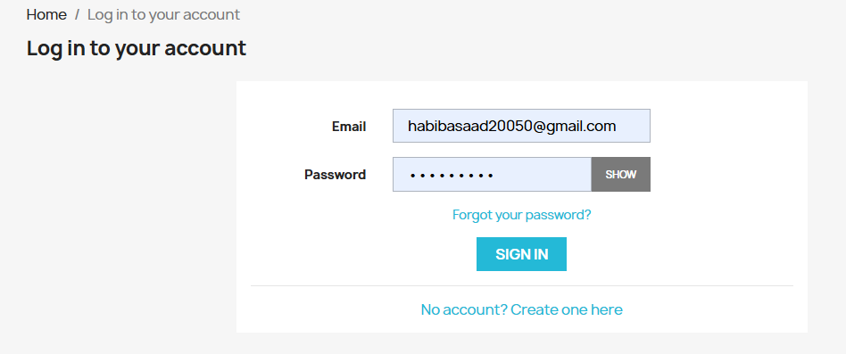
Project Wireframe
User logs in with email and password or creates a new account

Slide 5
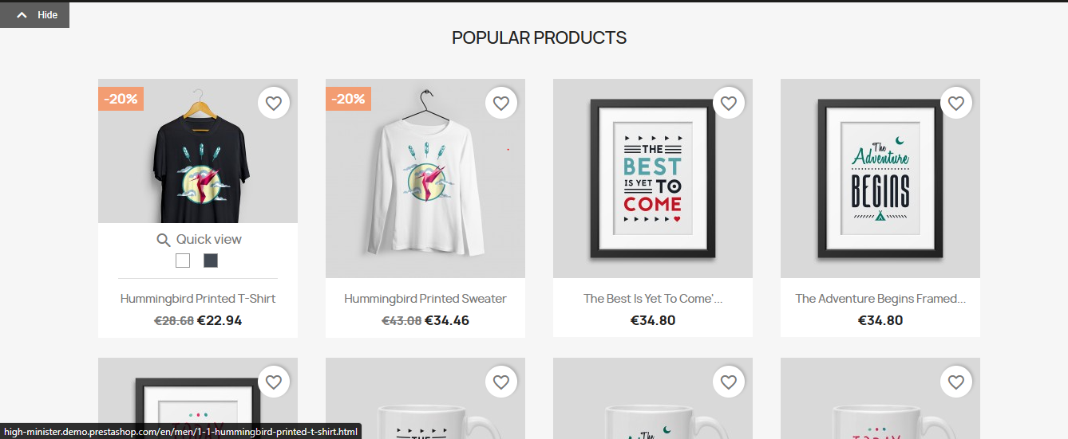
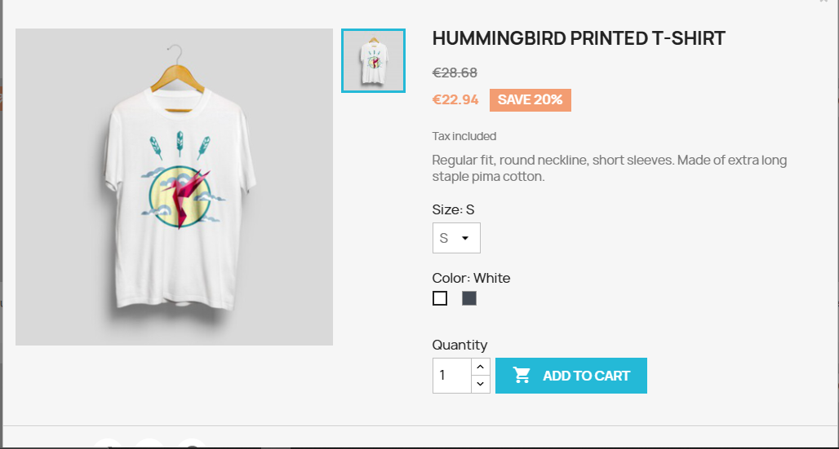
Project Wireframe
Browses popular products on the homepage, views product details, and adds items to cart.

Slide 6
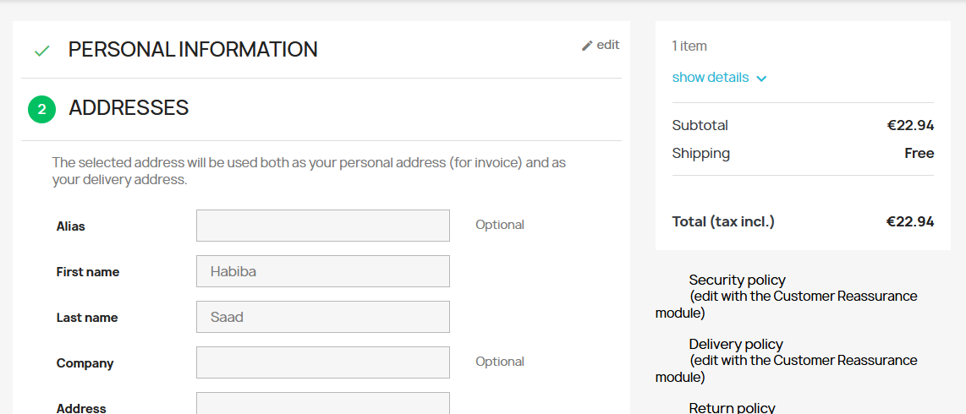
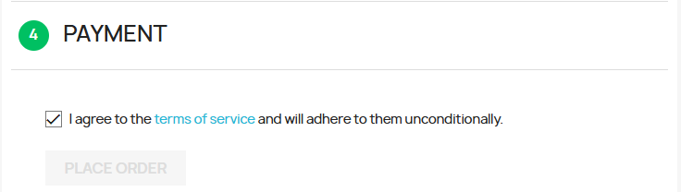
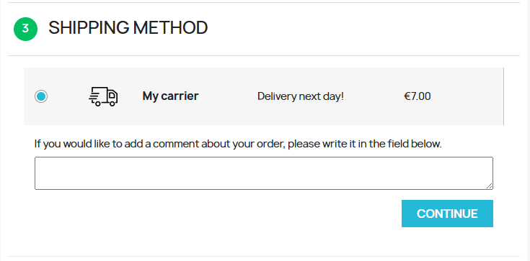
Project Wireframe
Reviews cart, enters personal and address details, selects shipping method, agrees to terms, and completes payment to place the order.

Slide 7
End Users + Features
Primary User Personas:
Individual Shoppers: Seeking easy navigation and secure checkout.
Store Admins: Managing product listings and orders.
Key Features Tested:
Product Search: Accuracy and speed.
Cart Management: Add/remove items, update quantities.
Checkout Process: Payment gateway integration, form validation.
Problem Solving: Ensures reliable transactions for shoppers and efficient management for admins.

Slide 8
Data Structure
Testing Scope: Focused on front-end and user-facing functionality of
https://demo.prestashop.com/#/en/front without direct database access.
Data Inputs Tested:
User Inputs: Search queries, form submissions (checkout forms), cart updates.
System Responses: Product listings, error messages, confirmation pages.
Data Flow Validation:
Input Collection: Verified through UI interactions (form submissions).
Output Display: Ensured correct rendering of search results, cart contents, and checkout summaries.

Slide 9
Programming Languages + Frameworks
Languages:
JAVA: For automated testing scripts.
Frameworks/Tools:
Selenium: Browser automation for functional testing.
JMeter: Performance and load testing.

Slide 10
Live Application + Test
Current State: Testing conducted on live demo
(https://demo.prestashop.com/#/en/front).
Testing Phases:
Integration Testing: Integration Testing was conducted by linking system data across user workflows, especially the checkout process.
User Testing: Collected feedback focused on:
Ease of use
Responsiveness on various devices
Overall user experience

Slide 11
Deliverables
Reports/Documentation:
Test Plan: Scope, objectives, and methodologies.
Bug Reports: Detailed issues with severity and steps to reproduce.
Test Cases: Detailed steps for each test scenario.
Test Scenarios: High-level conditions that outline what to test.
Timeline:
Project Planning: Completed Week 2.
Requirement Gathering: 2 Weeks .
System Analysis & Design: 2 Weeks .
Automated test scripts repository 3 Weeks .

Slide 12
Project Team + Roles
Name | Role | Key responsibilities
Shahd Ashraf | Automation test script developer | Create and execute automation testing scripts with testing and selenium
Al Shaimaa Ashraf | Test scenarios and test cases writer | Design test scenarios and test cases
Fatma Zaher | Automation test script developer | Create and execute automation testing scripts with testing and selenium
Habiba Saad | Performance Tester | Execute performance tests using JMeter to assess speed and stability. Perform load and stress testing.
Shahd Ghandi | Manual tester and bug reporter | Execute manual tests and defects
Rawan Arby | Manual tester and bug reporter | Execute manual tests and defects

Slide 13
Thank You

